Slide 1
Prison Break
Group 7: Adam Vanberkum, Simon Rankov, Ho Chon

Slide 2
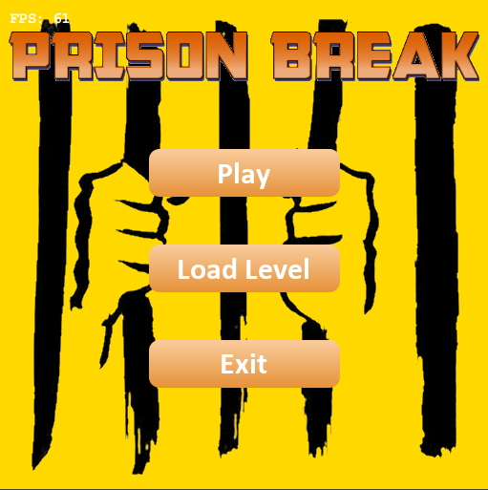
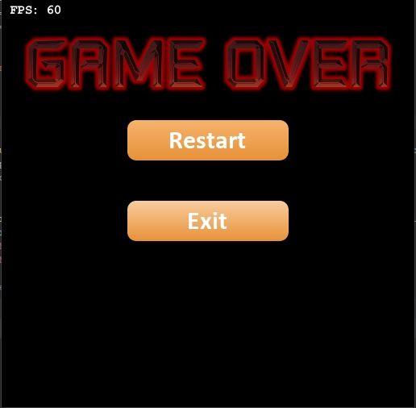
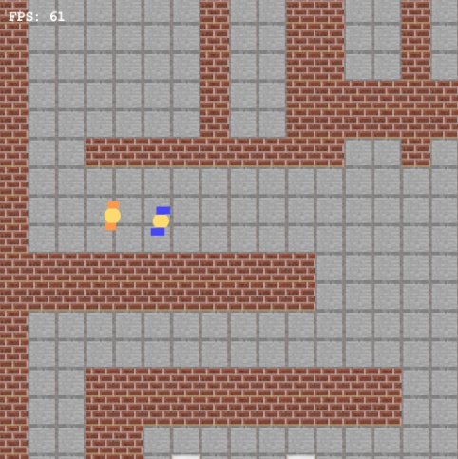
What is Prison Break

Slide 3
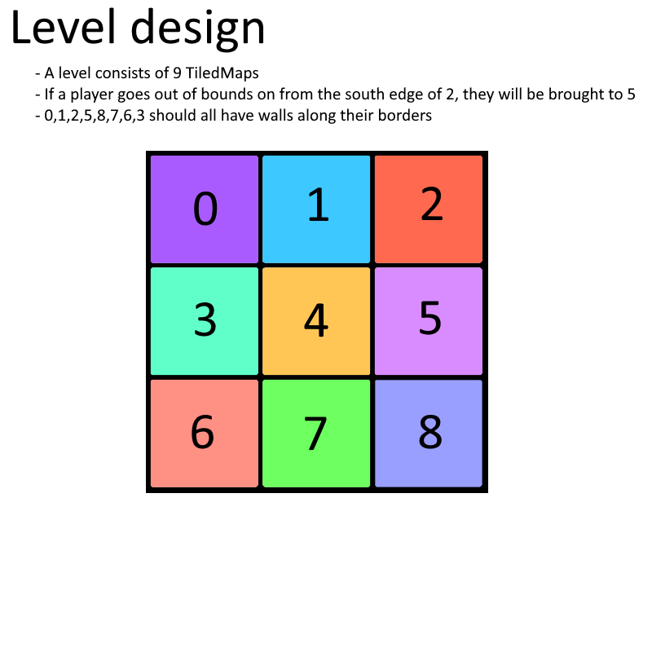

Slide 4
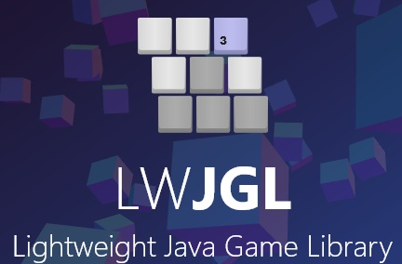


Libs and etc

Slide 5
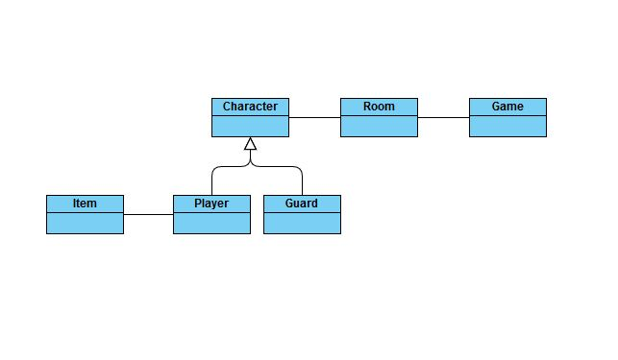
UML diagram

Slide 6
Demo

